Slide 1

BES171: 1) Banking 2) Finance 3) Insurance 4) Financial Inclusion
Debt
Corporate Governance
Equity
SENSEX
Companies Act
SEBI & Scams
Investment Funds
Derivatives

Slide 2



“finance” required to start a company or expand company..
Financial Market
Money Market
Capital Market
Primary
Secondary
Short term upto1 year
Long term >1 year
Govt: T-Bill, CMB,
Firm: C-Paper, Pro-notes
FI: CoD
Govt: G-Sec, sovereign bonds
Firm: IPO, share, bond (=debentures)
Securities resold here

Slide 3
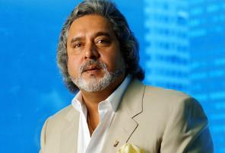


In primary market on 1st April 1979, if Kingfisher IPO was issued
30k with Mallya
70k with public
Free Float Market Capitalization
= no. of shares with public x price
= 70,000 x 10 = 7 lakh. (1979)
3

Slide 4

Towards SENSEX
Financial Market
Money Market
Capital Market
Primary
Secondary
Short term upto1 year
Long term >1 year
STAG (Male Deer)
Investor who buy newly issued securities, quickly sells them in secondary market for quick profit.
Securities resold here

Slide 5
Stock exchange chronology has been asked in UPSC
World’s Oldest:
ASIA oldest:
India’s Oldest
Amsterdam Stock exchange (1602) Netherlands
Bombay Stock Exchange (1875)
BSE->A’bad->Kolkata->NSE

Slide 6
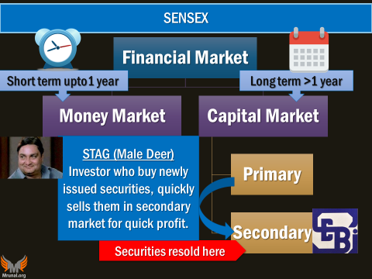

FFMC (1979)
70k x 10 = 7 Lakh
FFMC (2017)
70k x 2k per share = 14 crores
Bull
Hopes prices will rise, so purchases
Bear
Fears prices will fall so, SELLS

Slide 7
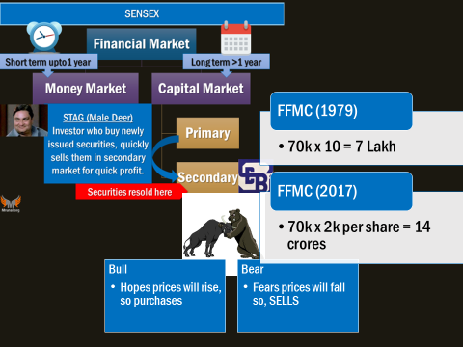

What is SENSEX?
(Sensitive index)
weighed average of FFMC of 30 companies, selected by BSE’s “Index Cell”.
$$BSE SENSEX=FFMC \left(@\frac{present}{Base Year} ∗100\right)=\left(\frac{14 crore}{7 lakh}∗100\right)=20,000 SENSEX$$

Slide 8
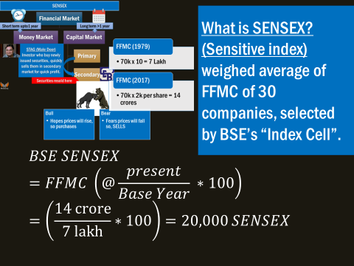
Down
War, Inflation, political instability
UP
soft monetary policy, relaxing FDI norms, M&A rumors

Slide 9
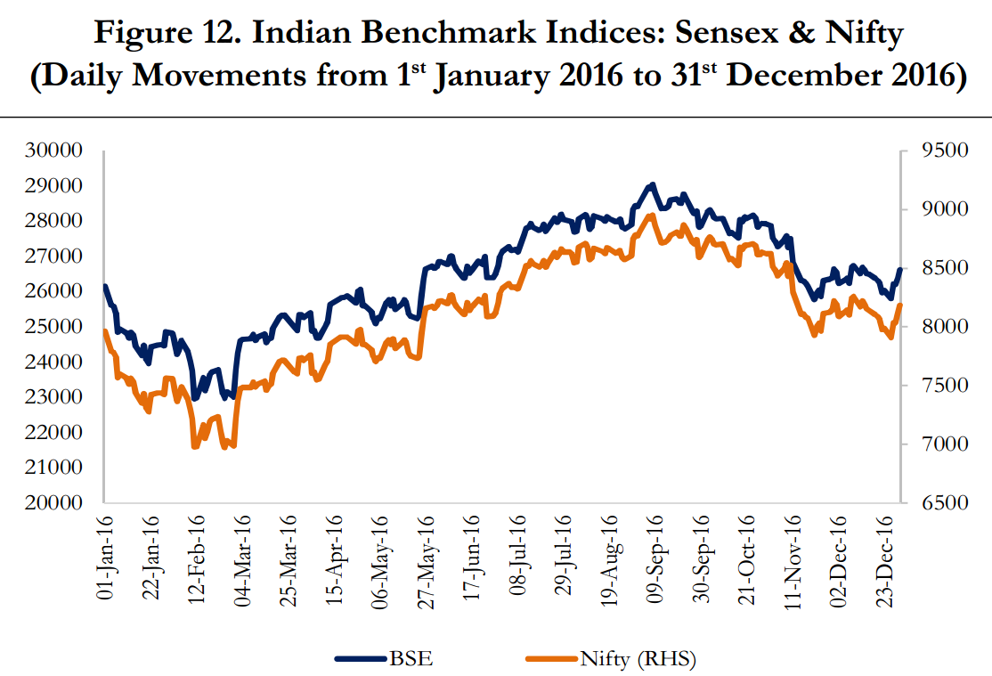
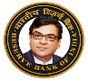

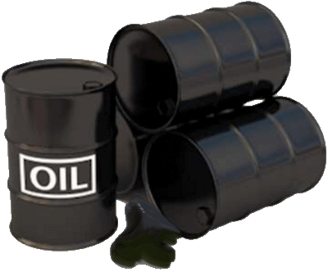
New Governor, rate cut
SENSEX: 800 pt. ▼“Bloodbath” “Bearhug”
▼Q3 profit SBI, Tata et al.
US fed: US & global turmoil
OPEC deal for cutback
BREXIT referendum
Demonetization (385)
US Election outcome [IT, Pharma ▼]

Slide 10
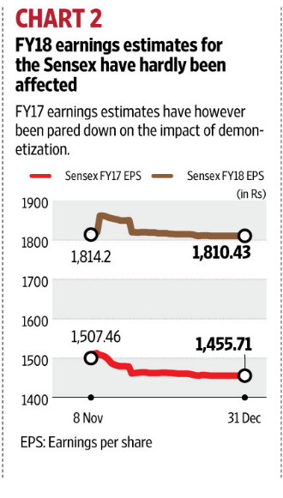
Impact of demonetization: felt, but not “DRASTIC”
IPO (Primary Market)
Share market Liquidity, “EXIT”
UP / DOWN
“Response” to future IPO

Slide 11
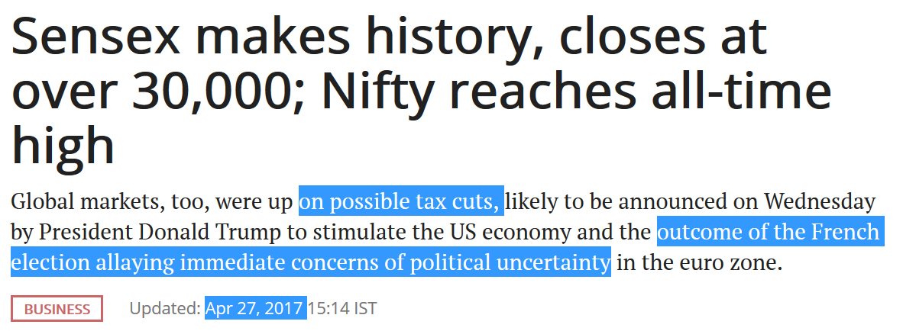
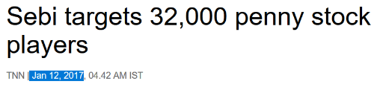
But SEBI warns about “Penny Stocks”.
USA <$1 value.
India: upto Rs.10 per share, and very low market capitalization. Mainly used by scamsters to launder black money.

Slide 12
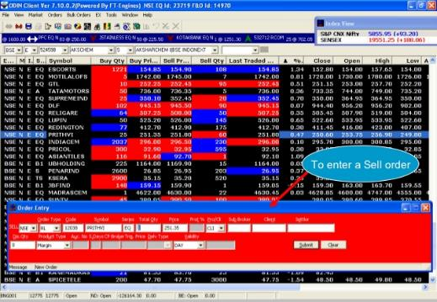
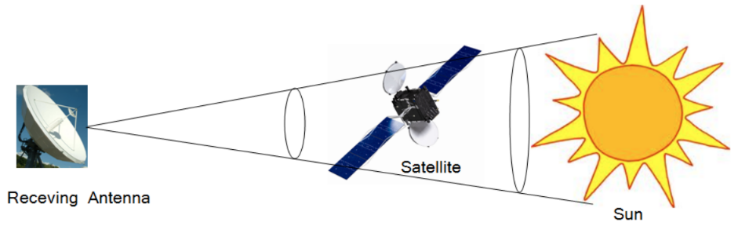
BOLT: BSE’s online trading system
NEAT: NSE for automated trading
VSAT (Very Small Aperture Terminal) won’t work during solar flares & equinox- because it’s geostationary satellite

Slide 13
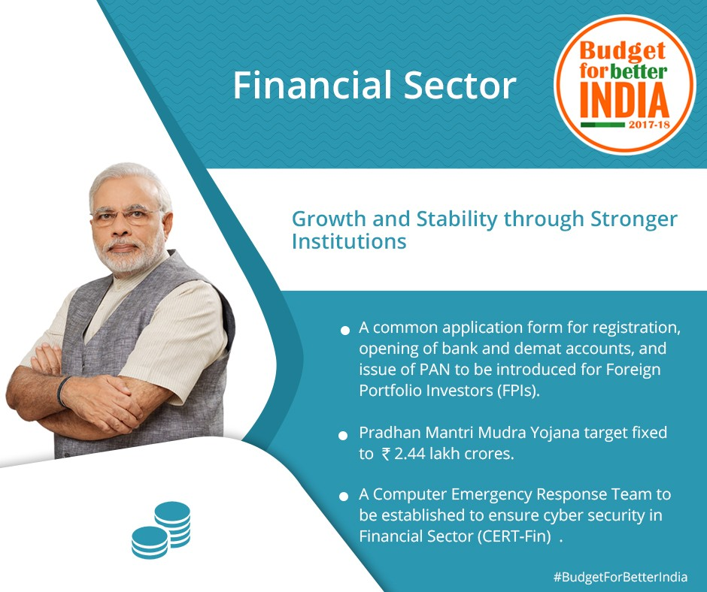

Will setup a Computer Emergency Response Team for our Financial Sector (CERT-Fin)
CBS, online trading etc. will become more secured protected

Slide 14
BES171: 1) Banking 2) Finance 3) Insurance 4) Financial Inclusion
Debt
Corporate Governance
Equity
SENSEX
Companies Act
SEBI & Scams
Investment Funds
Derivatives

Slide 15

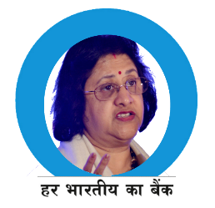
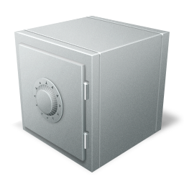
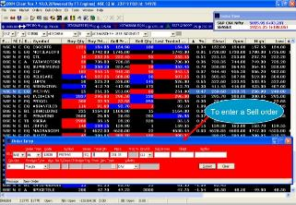
If online trading, then where are the physical shares & Bonds?
Depository
CSDL
NSDL
Dep.
Participant
SBI
HDFC
ICICI
Customer
DEMAT account
Fear of Delay, theft hence ‘dematerialization in mid-90s’
NSDL also got license for payment Bank
Notes:
National Securities Depository Limited (NSDL)

Slide 16

Roopal Panchal IPO Scam DEMAT SCAM (2003-05)
Forged documents and photos from Shaadi.com-> multiple DEMAT accounts
PAN Card was not mandatory for IPO applications upto Rs.50,000/-
Multiple Bidding in IPO, more chances of allotment, sell in stock market.
Steps taken: PAN compulsory for all bidding, ASBA (Applications Supported by Blocked Amount), RBI punished banks, SEBI banned operators
Demad SCAM
Notes:
http://www.rediff.com/business/report/pix-special-the-ipo-scam-that-changed-indias-primary-market/20160802.htm

Slide 17
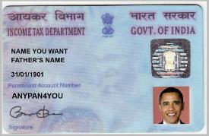
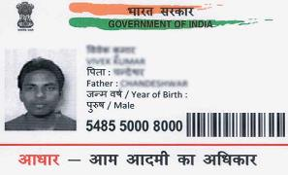
Name
Permanent Account Number (PAN)
UID- Aadhar
Who issues?
Income Tax Dept
Unique Identification Authority of India
Structure
10 digit alphanumeric number (A-Z)(0-9)
12 Digits unique number (0-9)
Changes with Address?
No
No

Slide 18
Eligibility
Residents, NRIs (individual, firms)
Resident, NRIs (only individual)
Age limit
No min. / max.
<3 years = fingerprint..x; later on captured.
Fees
~Rs.100/-
None
Biometric Data
Only photo
Eye (Retina), photo, finger

Slide 19
Black money, scams
multiple / duplicate PAN Cards made using fake id-papers.
Black money invested in stock market. Terror finance angle.
So Aadhar linking of DEMAT accounts.

Slide 20
East of Doing Biz
Registration of MF, Brokers, portfolio managers- fully online by SEBI.
Common Application form for Foreign portfolio investors (FPI)
PAN card [CBDT]
Demat account [SEBI]
Bank account [RBI]

Slide 21
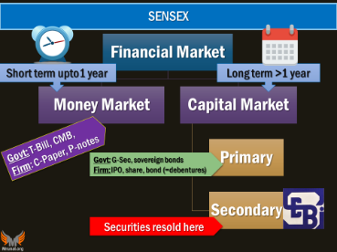
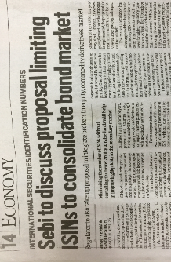
Measures to deepen of Capital market, Corporate Bond Market, while protecting small investors..
Arrange finance from “non-Banks”
NPA, infra growth
Technical measures: retail investors: tax ▼; security
AIFI, EPFO, LIC etc. mobilize
Foreign Investors Restrictions ▼
NO need to follow minute developments. The gist is always this

Slide 22
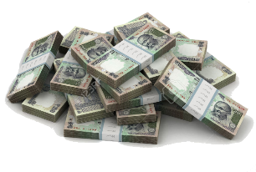
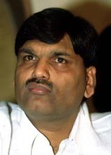

SCAMS and circuit breaker?
Harshad Mehta: Ready forward deal from Banks (1000 cr.)
Ketan Parekh
Madhupura Cooperative (1k cr)
Global Trust Bank (250 cr.)

Slide 23
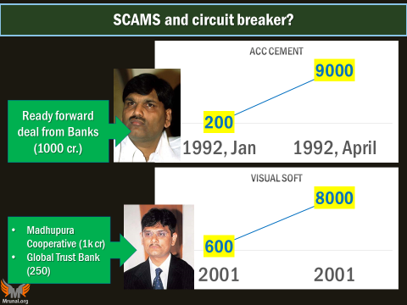
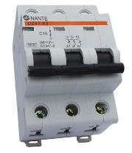
Circuit breaker?
10% up or down
1 hr halt
15%
2 hr
20%
Whole day
If we don’t stop then small investors will loose.
It’ll Hurt “deepening” of capital market.
Benchmark: previous day’s BSE-SENSEX or NSE-NIFTY

Slide 24

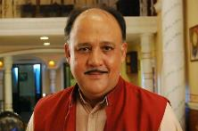
Badla system: Carry forward system, “betting” on borrowed money.
Pay only interest during that period.
Share
Rs.1000
Share
Hoping it’ll rise to 10,000, I’ll sell third party..
Keep till 60 days
before
T+(upto) 72 days
After
T+2 days

Slide 25

Dabba Trading? Or “Bucketing”
Betting
Speculation
Broker uses BOLT/NEAT software..to check price,
but trade happens only in his “Dabba” (unofficial ledger.)
Why this is bad and illegal?
Client defrauded with lure of ‘higher returns’.
KYC, Stock exchange Fee, Service tax, Income tax.
SEBI rules on Execution settlement.
Securities Contract Regulation Act. Transaction must be done via Stock exchange or face-2-face in 24 hrs.
Notes:
Securities Contract Regulation Act

Slide 26

Securities and Exchange Board of India (SEBI) भारतीय प्रतिभूति और विनिमय बोर्ड, Mumbai
1988
Executive order
1999
1992
Statutory Body
SAT
Amendment
Collective investment Schemes-CIS under SEBI. (Except Nidhi, Chit fund and cooperatives) later..but if >100 cr. Then under SEBI
GSM2: Functions over “securities”
Process of Securities issue (IPO, FPO, ETF..)
Places (stock exchange, depositories)
Persons (individual, brokers, MF managers, FPI, insider trading)
+ SCOPE online portal for complaint
Financial literacy of investors

Slide 27

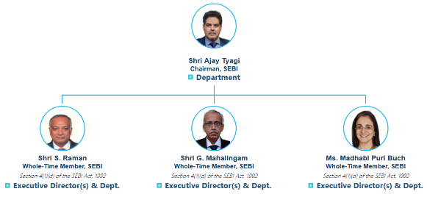
Securities and Exchange Board of India (SEBI)
2008-11
SAHARA Optionally Fully convertible Debenture (OFCD)
SEBI Permission….X
2011
SEBI: refund with 15%, untraceable account holder to Govt.
SAT, SC upheld
->Bail in and out
2014 amendment
Powers to Search seizure arrest similar to Income Tax.
2015
Forward Market Commission merged after NSEL commodity scam.
2017
Chief Ajay Tyagi (IAS) for 5 YEARS

Slide 28

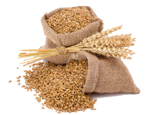

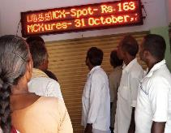



Commodity Trading
AGRI:
Castor seeds, cotton, wheat, basmati
METAL:
Aluminum, gold, silver
ENERGY:
Oil, coal
Warehouse
receipt
Commodity Market
NWR- Bank loans
NSEL promoter Jignesh Shah generated fake warehouse receipts. ~5600 cr. Scam
FMC (agri)->merged with SEBI (FinMin) in 2015
Farmer

Slide 29


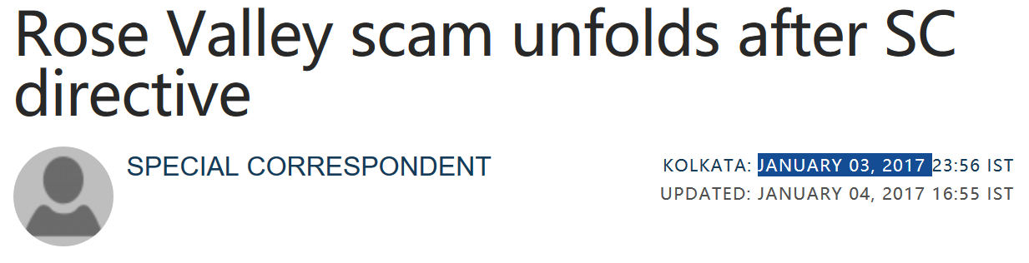
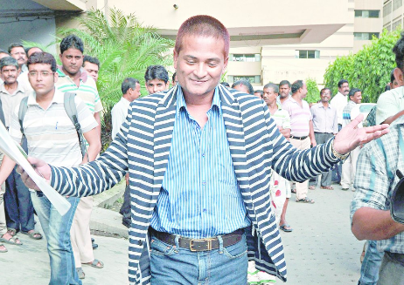
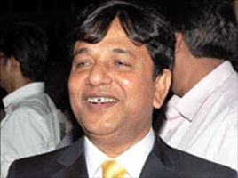
Saradha Fund
Sudipto Sen
X 7 =
Rose Valley [40-60k cr]
Punshukh Wangdu
Gautam Kundu

Slide 30
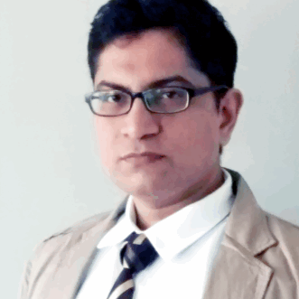



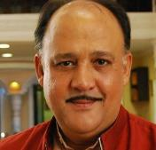
Chit fund: monthly 10k contribute x 3 months….
10,000
10,000
Commission
1,000
Total 30,000
10,000
Total 29,000 Remain

Slide 31
Put the ‘chit’- how much loan you need? “Auction”…Lowest bidder to get amount
29,000
28,000
Total 29,000
25,000
Remaining Rs.4000: equally distribute among members

Slide 32

First month, Alok Borrowed Rs. 25,000
Chit Fund
Game: give 10,000 x 3 months
Month#1: 10,000 [got, 25k] + [1/3rd of 4k but lets ignore that chain.]
Month#2: 10,000
Month#3: 10,000
Total returned= Rs.30,000
Loan = Principal + Interest paid
Loan = 25,000+ 5,000 = 30,000
Variants: motor cycle, fridge etc. and instead of auction, it can be ‘lucky draw’.

Slide 33
Chit fund
It’s a collective investment scheme (CIS)
People pool their savings by periodic installments.
Amount given to one of the member through luck draw or auction.
SC order: it’s a contract,
Contracts are concurrent list
UNION: Prize Chits and Money Circulation Schemes 1978
States: empowered under Chit Funds Act 1982
States: Kerala, TN, Andhra, W.Bengal

Slide 34
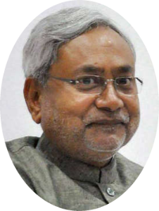

Modus operandi of Chit fund scams….
Multiple chit fund cos to dodge 100 cr..
Money routed from one to another.
Rope in TMC leaders, celebrities for endorsement.
Register as “CHIT Fund” with state Government.
It’s a Chit fund, so outside your purview.
Invested in hotel, real-estate, share market speculation etc.
Subprime crisis lost sheen.
Sometimes simply Ponzy.
2014: amendment if pooled money >100 cr.
Then CIS under SEBI
like MF/ReiTS..so SEBI jurisdiction comes.

Slide 35
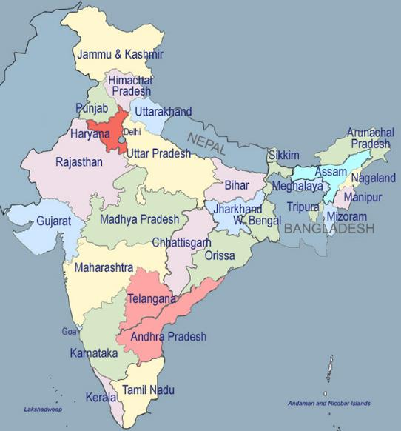
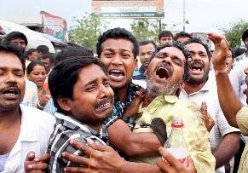
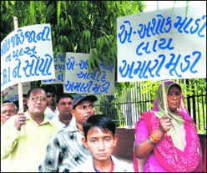
Ponzy, Multi-layer marketing Scams are not confined geographically
Zahir Rana (2003)
Ashok Jadeja (2009)
Mataa-ji in his dream, promising double money.
11% monthly return on Remo marketing (MLM)
550 crore
Jailed and released.
Poverty
High Inflation, Low Growth
Scam
Lure of quick return
Money Multiplier

Slide 36
Multi-State Cooperative Societies Act, 2002 (MSCS Act)
Law with loophole
Falls under Central Registrar under Ministry of Agriculture.
Scamsters transfer money to multi-state cooperatives.
Loaned out their kith and kin.
Difficult to recover funds.
Reforms
Transfer function to finmin [just like FMC]
More powers, special audit

Slide 37
Ponzi Scams
Will amendment Multi State Cooperative Societies Act, 2002.
Ponzi & illicit deposit scheme new bill drafted.

Slide 38
What if fraud in regulated financial intermediaries?
Banking | Finance(SEBI) | Insurance(IRDA) | NPS
In house | SCORES | Inhouse | NSDL
B.Ombd | SEBI | I.Ombd | PFRDA
Consumer court | SAT | Consumer court | Consumer Court
Court | Supreme court | Court | Court
Multiple regulators, lack of coordination and loop holes

Slide 39
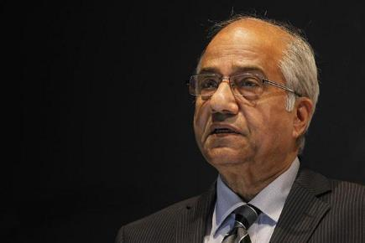

year | Act
1934 | Reserve Bank of India Act
1938 | Insurance Act
1944 | Public Debt Act
1949 | Banking Regulation Act
1952 | Forward Contracts (Regulation) Act
1956 | Securities Contracts (Regulation) Act
1961 | Deposit Insurance and Credit Guarantee Corporation Act
1970 | Banking Companies (Acquisition and Transfer of Undertakings) Act
1992 | SEBI
1996 | Depositories Act
1999 | FEMA Act
1999 | IRDA Act
2006 | Government Securities Act
2013 | PFRDA Act
Financial sector legislative reform commission (FSLRC)- Justice BN Sri Krishna [2011-13]
Indian Financial Code

Slide 40
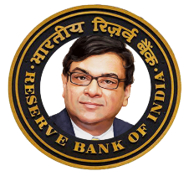

FSLRC: Present vs Future Agencies
RBI
RBI
Debt Mgmt
SEBI
FMC
IRDA
PFRDA
UFA
FSAT
FRA
SAT
Resolution Corp (DICGC)
Financial Data Management Centre
FSDC to monitor everything.
Notes:
United financial agency (UFA)
Financial Redressal Agency (FRA)
B. N. Srikrishna (2008-2013)
FinMin (2011-13)
resolution corporation would charge a fee to all firms based on the probability of failure.

Slide 41
Tribunal mergers
Done: FMC->SEBI (2015)
Problem: multiple tribunals with overlapping functions ☹
We propose to rationalize the number of tribunals and merge tribunals wherever appropriate.

Slide 42
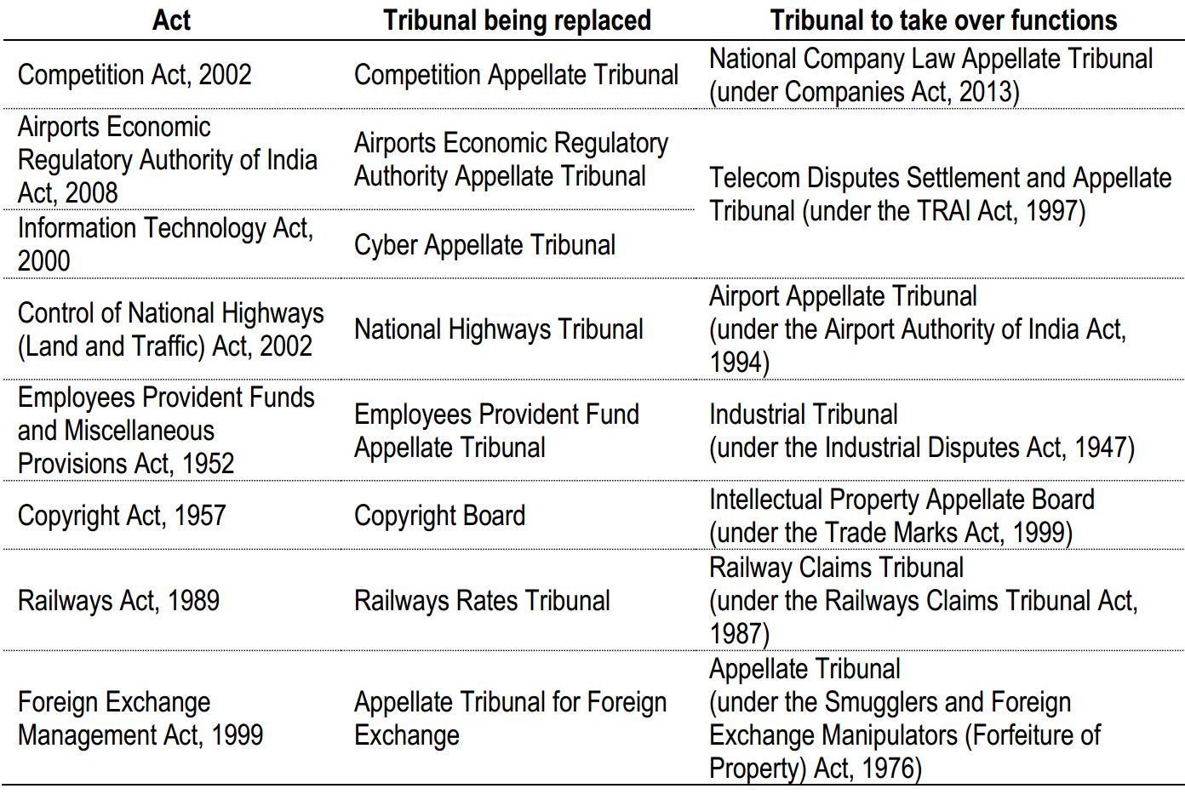
“Finance bill 2017” = Merger of “Appellate Tribunals”

Slide 43
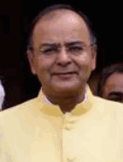

Financial Stability and Development Council (FSDC)?
Financial Stability Board (FSB)
Under G20 @BASEL,
Coordination between national bodies, since 2009.
Meets twice a year.
FM
RBI
SEBI
IRDA
PFRDA
Dept of Economic Affairs 2010
Coordination
Consultation
Literacy
Macro prudential supervision of the economy.

Slide 44
UPSC Prelims 2016
Correct statements about 'Financial Stability and Development Council':
It is an organ of NITI Aayog. <false>
It is headed by the Union Finance Minister. <true>
It monitors macro prudential supervision of the economy.
Answer Choices
1 and 2 only
3 only
2 and 3 only
1, 2 and 3

Slide 45
BES171: 1) Banking 2) Finance 3) Insurance 4) Financial Inclusion
Debt
Corporate Governance
Equity
SENSEX
Companies Act
SEBI & Scams
Investment Funds
Derivatives

